Slide 1


Slide 2


















OUR PARTNERS
PLATINUM
GOLD
SILVER
bronze
Media
partner
SUPPORTING PARTNERS

Slide 3

Ве молиме исклучете ги мобилните уреди
Please turn off your mobile devices

Slide 4





about me
Vlado Bozinovski - architect/engineer @ InScale
www.linkedin.com/in/vladobozinovski/
@vld_b
vlado-b
Notes:
My name is Vlado Bozinovski . I’m architect engineer working @ InScale. I’ve been in the software industry for over 12 years now .
I’ve been involved in various projects in many industries and platforms.
My background is mostly in .Net and JavaScript stack , alto I stared as a Java developer.
My aim is to help companies and teams deliver software more efficiently.
You can find me on linked in , twitter and github

Slide 5

What is reactive programing
Notes:
Reactive programing is a new paradigm in programing , similar to the object oriented ( or imperative) programing was before ,
It’s a different way/approach of thinking of problems , thus different way of thinking is really difficult to explain in 10 minutes 1 hour or 1 week
If we go to Wikipedia it would say that reactive programming is programming with asynchronous data streams . We’ll this is correct but we’ll get there .
Thus, this is an introduction , thinking in a reactive way
So the idea of the presentation is more to give you an idea on how we can solve some problems (and way) in a reactive way.
In order to start working with reactive streams one needs first
to change his/her mindset. So one can say that reactive programming is a mindset , just like agile was :-)

Slide 6
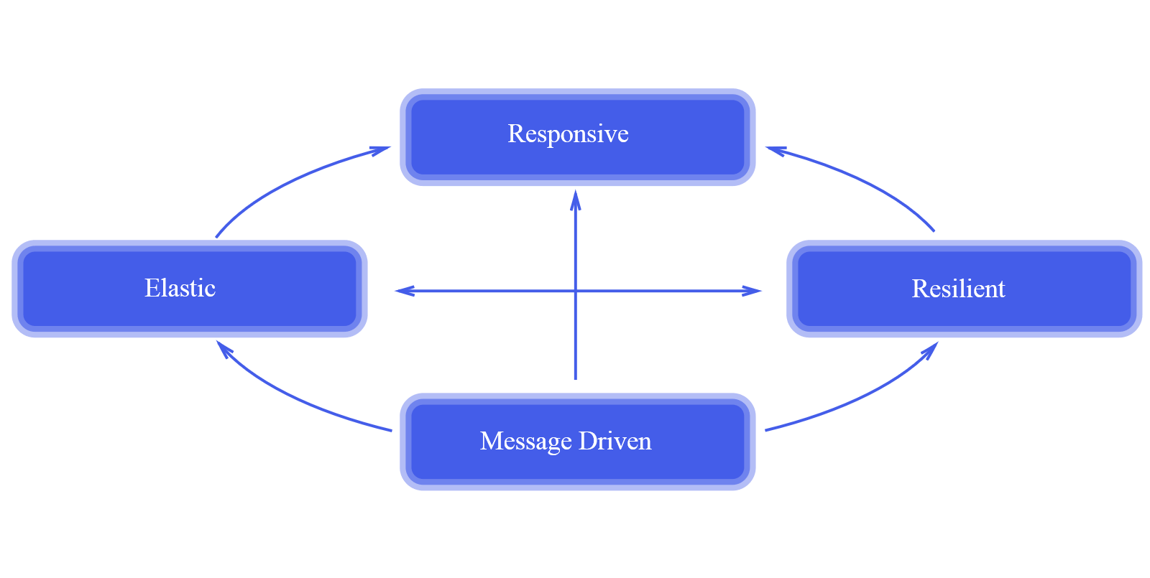
Reactive systems
React to the user/other systems
React to load
react to failure
React to events
Notes:
Before we go into the details of reactive programming let’s examine what are reactive systems as we have many terms that are inter-lapping , react , reactive programming , reactive systems , reactive streams and so on
Some of you probably have heard of reactive systems and reactive manifesto. Well reactive manifesto is a white paper written from some big players in the industry on how to design and architect distributed systems.
You have probably seen this image here which is the main image showing the attributes of reactive systems and what they are.
Over the years the requirements for the systems and applications have changed dramatically. The applications are required to be quire fast and responsive , to know to handle big load and scale , they should handle failure and so on. Todays applications are deployed in a distributed environments on many clusters on cloud having many processors and multi -cores. (from servers in the cloud to mobile devices).
Let’s go over each attribute on what it means
Responsive , this means that the system should respond in a timely manner either to the user input or other system
Resilient - this means that the system should stay responsive under failure
Elastic – this means that the system should stay responsive under load (should not how to scale)
Message driven – this means that the system should rely on asynchronous message passing
All of this sounds pretty complicated so let’s try to make it easier.
Responsive - react to user /input
Resilient – react to failure
Elastic – react to load
Message driven - react to events
As we can see there is a bit more to reactive systems. While reactive programming facilitates many of these aspects, be aware that we can do reactive systems event without reactive programming

Slide 7
Why reactive programming , what problem does it solve and why
it’s the future
Asynchronous programming is hard
Asynchrony is everywhere now
Real-time data
Managing complex state
Concurrency
…
Notes:
Now let’s get back to the reactive programming and why we should care , what problems does it solve for us.
If we go to Wikipedia it would say that reactive programming is programming with asynchronous data streams . We’ll this is correct but we’ll get there . ???
Well it’s the future (it’s the next hype ) ☺ we’ll that is not reason enough
We’ll asynchronous programming is hard in any environment (desktop, mobile ,web , server ..)
asynchrony is everywhere now (application startup, data access, animation , view model binding , user input/response …. )
We have real-time data everywhere now
Managing complex state
Concurrency

Slide 8
Why reactive programming , what problem does it solve and why
Memory leaks
Race conditions
Callback hell
Complex state machine
Error handling scattered on many places
Tracking user/ui events
Side effects
Maintainability (logic is scattered)
Notes:
All the things we said earlier causes problems like
Memory leaks
memory leaks
race conditions
callback hell
complex state machine
disjointed error handling / scattered error handling on many places
Tracking user events is hard
side-effects

Slide 9
Other solution(s)
Promises
Do it ourselves ( ad hock) ?
Notes:
Do we have any other solution for the problems that we just described and talked a out.
The first thing that pops in our mind is Promises(Taks..).
Well not really, promises are really great but are only part of the solution.
For example we cannot cancel a promise (at least not easy) .
For the callback hell, we are just linearizing it and it’s not the solution.
Promises can return only one item.
We will describe the issue with promises in a later demo where we will show example with and without promises.
Another solution would be , just do it ourselves (ad hock) – we’ll this is not really a solution

Slide 10
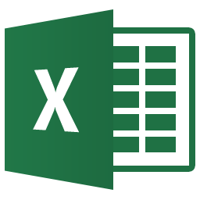
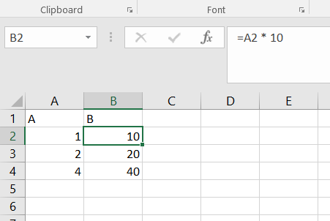
Reactive programing to the rescue
b = a + 10
We already have this for decades ?
excel is ‘reactive’
Notes:
So how do we solve the problems that we described earlier , after we saw that the other solutions are not really a solution , or at least they are
not solving all aspects of the problem.
Reactive programming comes to the rescue . Reactive programming aims to ease and solve these problems, and make more elegant solutions for some of them.
Some will say we already have this for decades in excel.
(Open the excel example , show the formula ) we’ll many it and non it people have been working ‘reactively’ for some time now. As you can see excel is reacting to the changes.
Many people love it because we have the data and the formulas on top of them and we are manipulating them instantly.
In an imperative programing if we define b = a + 10 once the value of a changes the value of b stays the same , where in a reactive programming is will change as well.

Slide 11

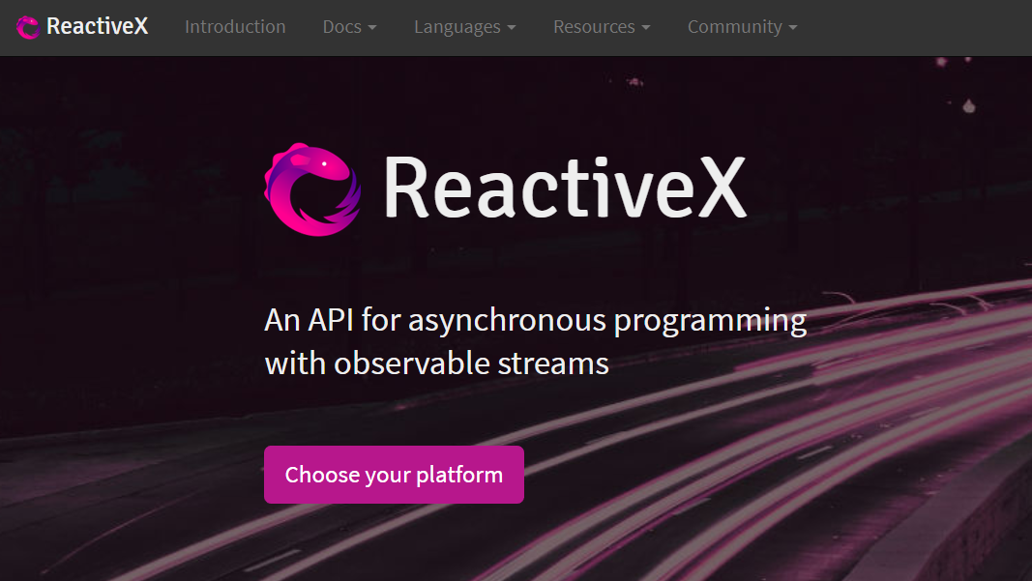
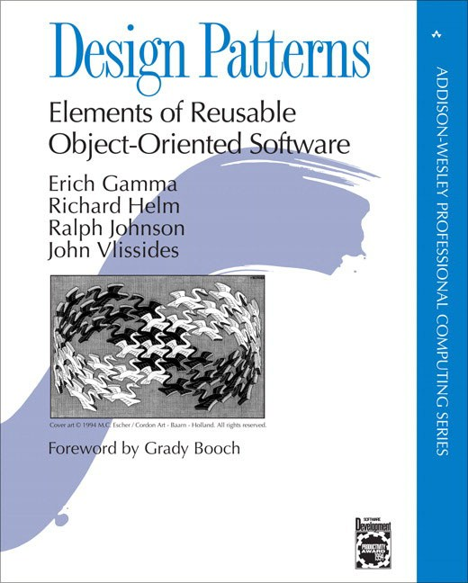
Reactive extensions (Rx)
Notes:
Reactive extensions is an open source library for reactive programming.
If we just lookup the definition we’ll see that Rx is “Rx is an api for asynchronous programming with observable streams )”
Reactive extensions Rx is trying to solve this using the same paradigm across different platform and languages.
Rx is the acronym for Reactive Extensions and form now on we will refer to this as Rx.
At the hart of the Rx are the observables.
Before we go into more details on Rx and observables let’s give a bit history and context to Rx.
Some of you probably read (definitely should) the GOF book Design Patters which was released in 1994.
(one of the books authors is the inventor/lead persons of the VS Code editor , Eclipse editor , JUnit ( the first testing framework with Kent Beck)
This famous book , described most of the important and widely used design pattern in the software engineering.
Among the other patters that the book contained it had the Iterator pattern and the Observer patter.
What the book didn’t associate is the correlation between these two patters.
In iterator we are pulling data where in the observer patter we are pushing data to the subscribers .
So the observables (and Rx) are basically it's a combination of the iterator , observer pattern and functional programming (including lot of useful operators that are concurrent).
What is the difference between arrays and events – nothing one is sequence in memory while the other is sequence in time.
So if we use the same analogue, we could operate on events are they would be arrays.
This means that everything is a stream

Slide 12



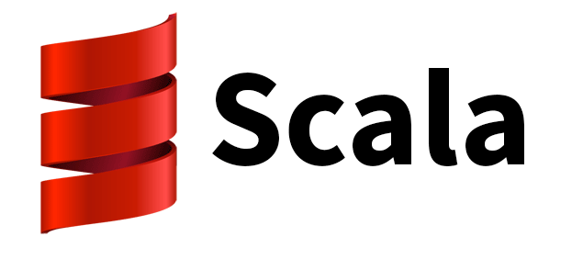




Reactive extensions (Rx)
written for C# by Erik Maijer @ Microsoft
Notes:
The Rx were initially written for C# by Erik Maijer from Microsoft.
He is a Dutch computer science professor that worked in Microsoft at that time and previously worked on the C# and Linq.
Rx has implementations for all mayor platforms and languages , from java , JavaScript, android , Kotlin, ruby , php scala and many more
The important thing is that Rx shares the same paradigm and model on different platforms and languages.
Alto there might be some syntax or implementation differences, the concepts and operators are pretty similar.

Slide 13
Reactive extensions (Rx)
observable
observer
subscriber
Subject
Notes:
Before we go into more details on how Rx works and see the demos , lets first covert some basic terms and concepts that are vital for Rx.
First of all the key or basic concept in Rx is the observable, simply put the observable is the source of events. The observable is the source stream that emits the events/items.
Lets give the analogue of the observable as the producer or some events or data. The observable is the subject that is emitting the events , the stream.
The observer is the subscriber of these events , of the stream on the observable.
The subject can act both as the observer and the observable.

Slide 14
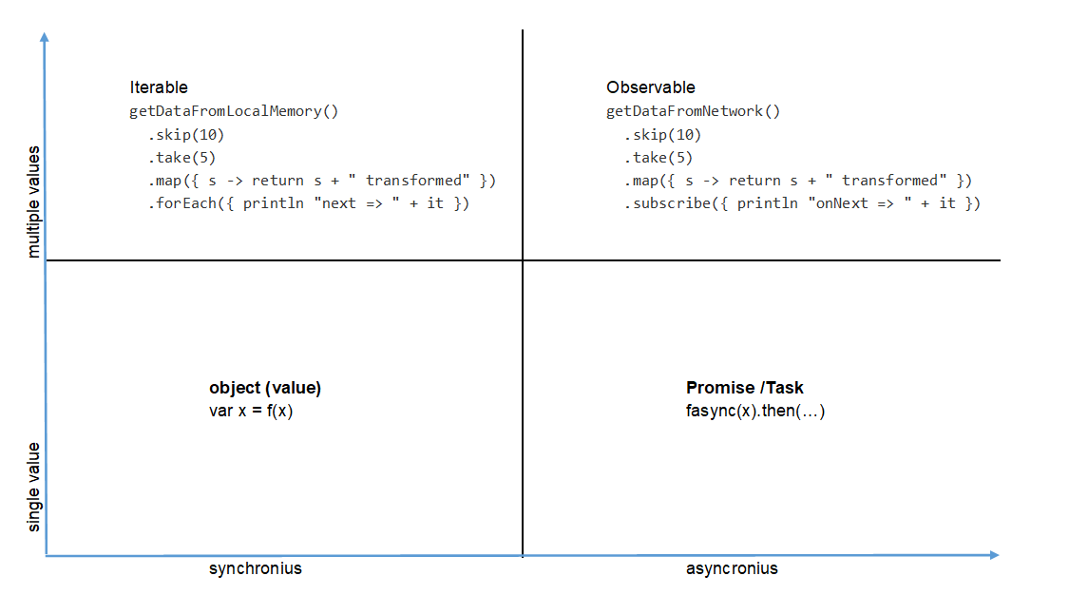
Rx synchronous vs asynchronous
Notes:
Let’s see once more why the Rx model is so compelling to us.
If we make a diagram and divide into four categories our code we would have synchronous , asynchronous, single value and multiple value .
So we have synchronous code on the left had side and asynchronous code on the right hand side. For the async code that returns a singe value we have the promises or the Task/Future structures.
Both can return single and multiple values, as we see the observables are also applicable to the asynchronous code that is returning multiple values ;
Let’s closely examine the inerrable and observable , as you can see they are pretty similar and the observables allows us to write async code in that manner. This is the compelling reason to use Rx.

Slide 15
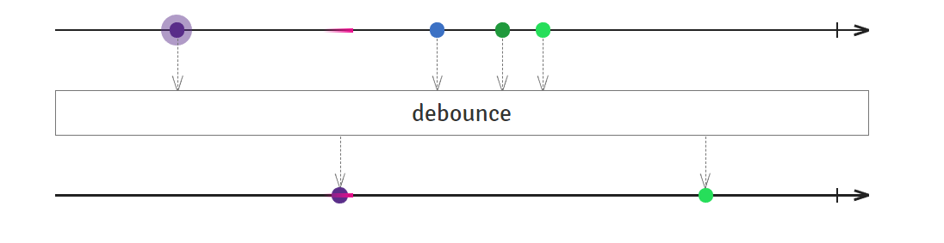
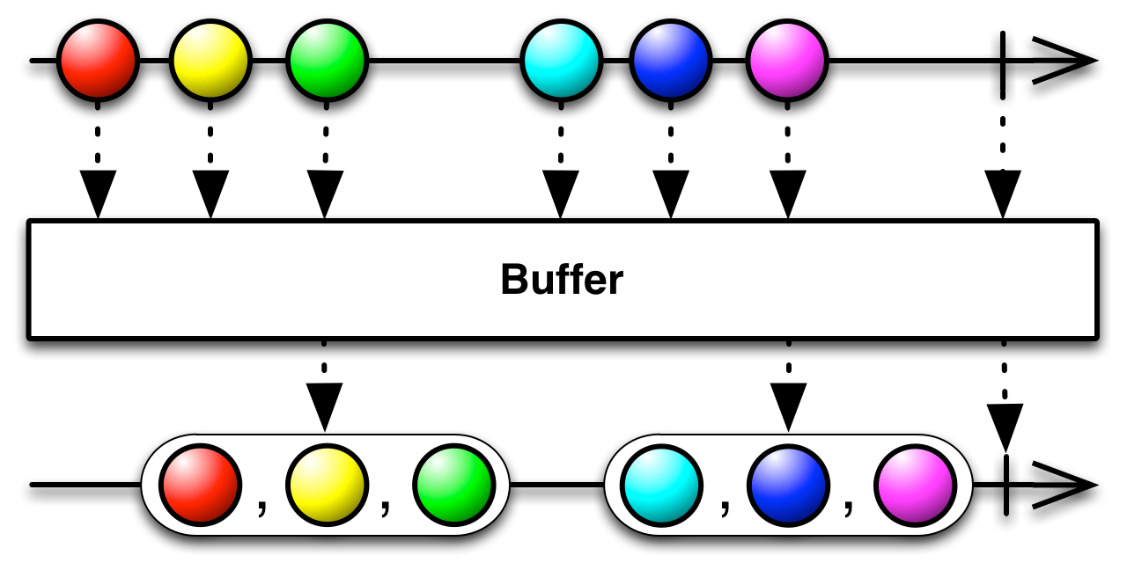
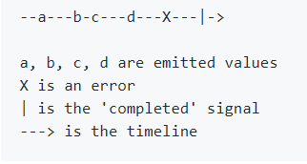
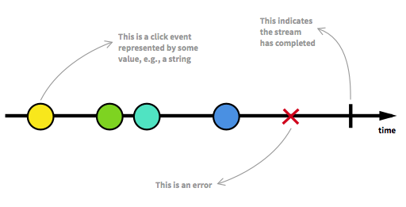
Rx marble diagrams
Notes:
Before we go into the demo , we’ll need to

Slide 16
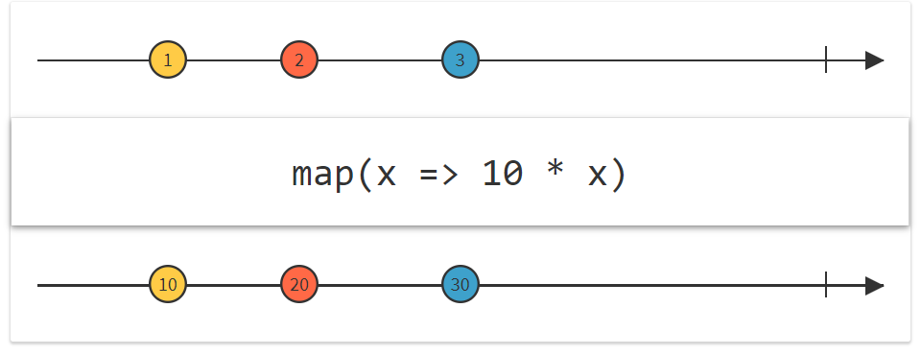
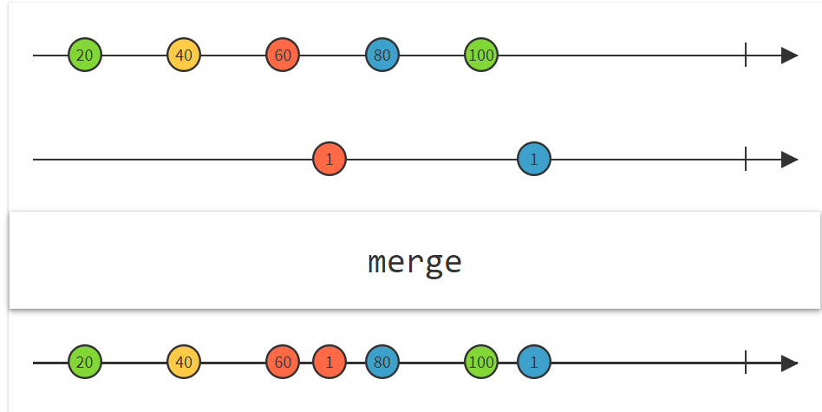
Rx operators
Notes:
One the strengths are the many operators.
They can be combined chained in many, many ways so we can fulfill our needs.
The rx website is the main place and reference for the operators , along with the diagrams we can see how they work and even decide which operators we need.
There is also a decision tree where we can look up the operator that we want based on the need we have.

Slide 17
Demo time
Rx in JavaScript
Rx in .NET
Rx on the client
Rx on the server

Slide 18

Thanks!
Any Questions?
Don’t forget that our code should be reactive
and we should be proactive :-)

